Slide 1
Earth System Modelling in New Zealand: What have we achieved?
Olaf Morgenstern
NIWA, Wellington
Notes:
Need to sort footer for first two slides***

Slide 2
Overview
Timeline of global climate modelling in New Zealand
Achievements
Challenges and problems
Benefit to New Zealand: Why do we require an Earth System Modelling capability?
Future of climate modelling in NZ

Slide 3
Timeline of global climate modelling in NZ
1999: NIWA starts using the Unified Model, in partnership with UK MetOffice
~2002: Chemistry-climate modelling starts at NIWA Lauder (Greg Bodeker, Hamish Struthers) → Support Lauder stratospheric measurements, international model intercomparisons
2008/2009: Change in personnel (OM and Guang Zeng replace Hamish Struthers and Greg Bodeker). New model (whole-atmosphere chemistry)
2011: The model becomes a coupled atmosphere-ocean chemistry-climate model
2014: Deep South NSC starts. New remit: Use global modelling to inform climate adaptation in NZ.
2015: Academic NZESM user teams get started. Development of the NZESM
~2020: Completion of NZESM Shared Socioeconomic Pathway projections
2024: Global modelling ends at NIWA. 😭

Slide 4
Achievements
Set up, configured, and developed the NZESM community model (a variant of the UK Earth System Model)
Fed back model advances to UKESM development
Recruited non-NIWA NZESM users (presently U. Otago, U. Canterbury, VUW)
Contributed to international modelling projects (Southern Ocean Freshwater release Initiative, Chemistry-Climate Model Initiative, Aerosols and Chemistry Model Intercomparison Project, Unified Model Partnership)
Contributed to international reports (IPCC 6th Assessment Report, WMO Ozone Assessments, World Climate Research Programme reports)
Lengthy publication record in the peer-reviewed literature
NZESM simulations were downscaled using the NZ Regional Climate Model (12 km resolution), and some to 2.2 km resolution.
Some NZESM downscaled data (12 km) will be handed to MfE, to be made available to NZ users.

Slide 5
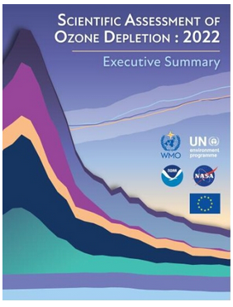
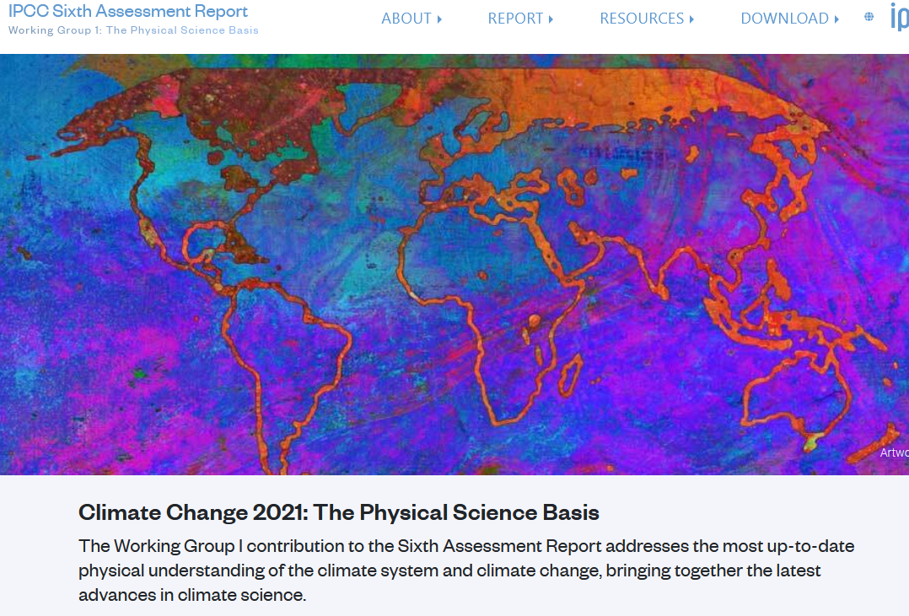
International and domestic involvements

Slide 6
Challenges
Extremely small team (compared to overseas modelling endeavours) → requires careful choice of problems to tackle
Inflated language at start of the DSC set the wrong expectations.
NZESM was derived from Hadley Centre Global Environment Model (HadGEM3). At an “equilibrium climate sensitivity” of 5.6K this is a “hot” model. → We did not make the downscaling results immediately publicly available.
Downscaling always required a set of base models, not just one. But that was not resourced until ~2022.
Downscaling was meant to bridge the gap to Impacts and Adaptation projects. But these data are only now available.
“Deep South” started as an Antarctic / Southern Ocean research challenge. But a lot of climate events also come from the North.

Slide 7
2015 flow diagram of Deep South research
None of these linkages are easy… (Image credit: Sam Dean, NIWA)

Slide 8
Benefit to New Zealand
Much of our understanding of past and present climate, and all our understanding of future climate, comes from global climate models.
There are >100 CMIP6 models to choose from.
Downscaling requires an in-depth understanding of the driving global climate models.
There are community-wide shortcomings in these model simulations (tropical cyclones, Antarctic sea ice, …) that influence simulated local climate.

Slide 9
Downscaling the NZESM
Annual-mean precipitation change 2081-2100 minus historical.
(left) SSP370, 2.2 km NZESM-NZRCM
(centre) SSP370, 12 km NZESM-NZRCM
(right) RCP8.5, 30 km CMIP5 mean -UM4.5
Credit: Stephen Stuart (NIWA)

Slide 10
Future change in surface wind speed
Annual-mean surface wind speed 2081-2100 minus historical.
(left) SSP370, 2.2 km NZESM-NZRCM
(centre) SSP370, 12 km NZESM-NZRCM
(right) RCP8.5, 30 km CMIP5 mean -UM4.5
Credit: Stephen Stuart (NIWA)

Slide 11
Climate modelling: The future
A climate modelling capacity remains critical for the NZ adaptation journey.
Climate change is manifesting most visibly in extreme events. These are hard to capture for global model. Human expertise required.
Climate modelling (globally and locally) is dependent on long-term observations. We should make sure to continue to make these observations (trace gases, oceanic observations, meteorological stations etc.)
Global climate modelling expertise is moving from NIWA into academia. But universities in general do not have the strategic remit to hold up this critical knowledge.
Hiding climate data behind a pay wall is hindering climate adaptation.
NZ has moved progressively towards competitive, erratic funding. This makes building and retaining critical capacity very difficult.
I wish the remaining academic global modelling partners (UO, UC, VUW) all the best.

Slide 12
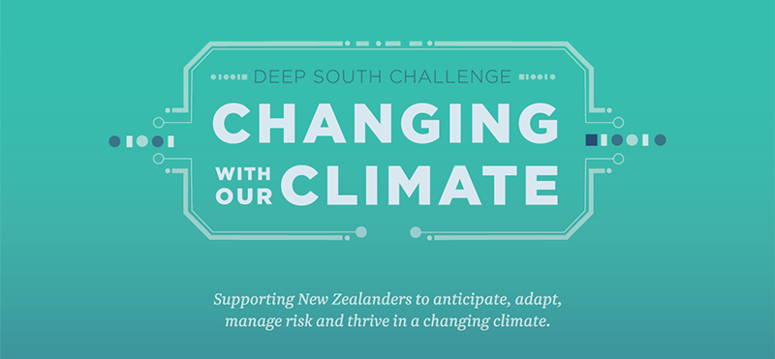
Thank you

