Slide 1
Modelling Antarctic Sea Ice
Andrew Pauling, Inga Smith, Max Thomas, Shona Mackie, Pat Langhorne, Jeff Ridley, Torge Martin, David Stevens and the SOFIA Team

Slide 2
What is sea ice?
Frozen seawater at the ocean surface
Formed from salt water
Typically about 1-2 m thick
Varies between 2 and 20 million km² annually (a variation of more than 60 times the size of NZ)
Figure from https://zacklabe.com

Slide 3
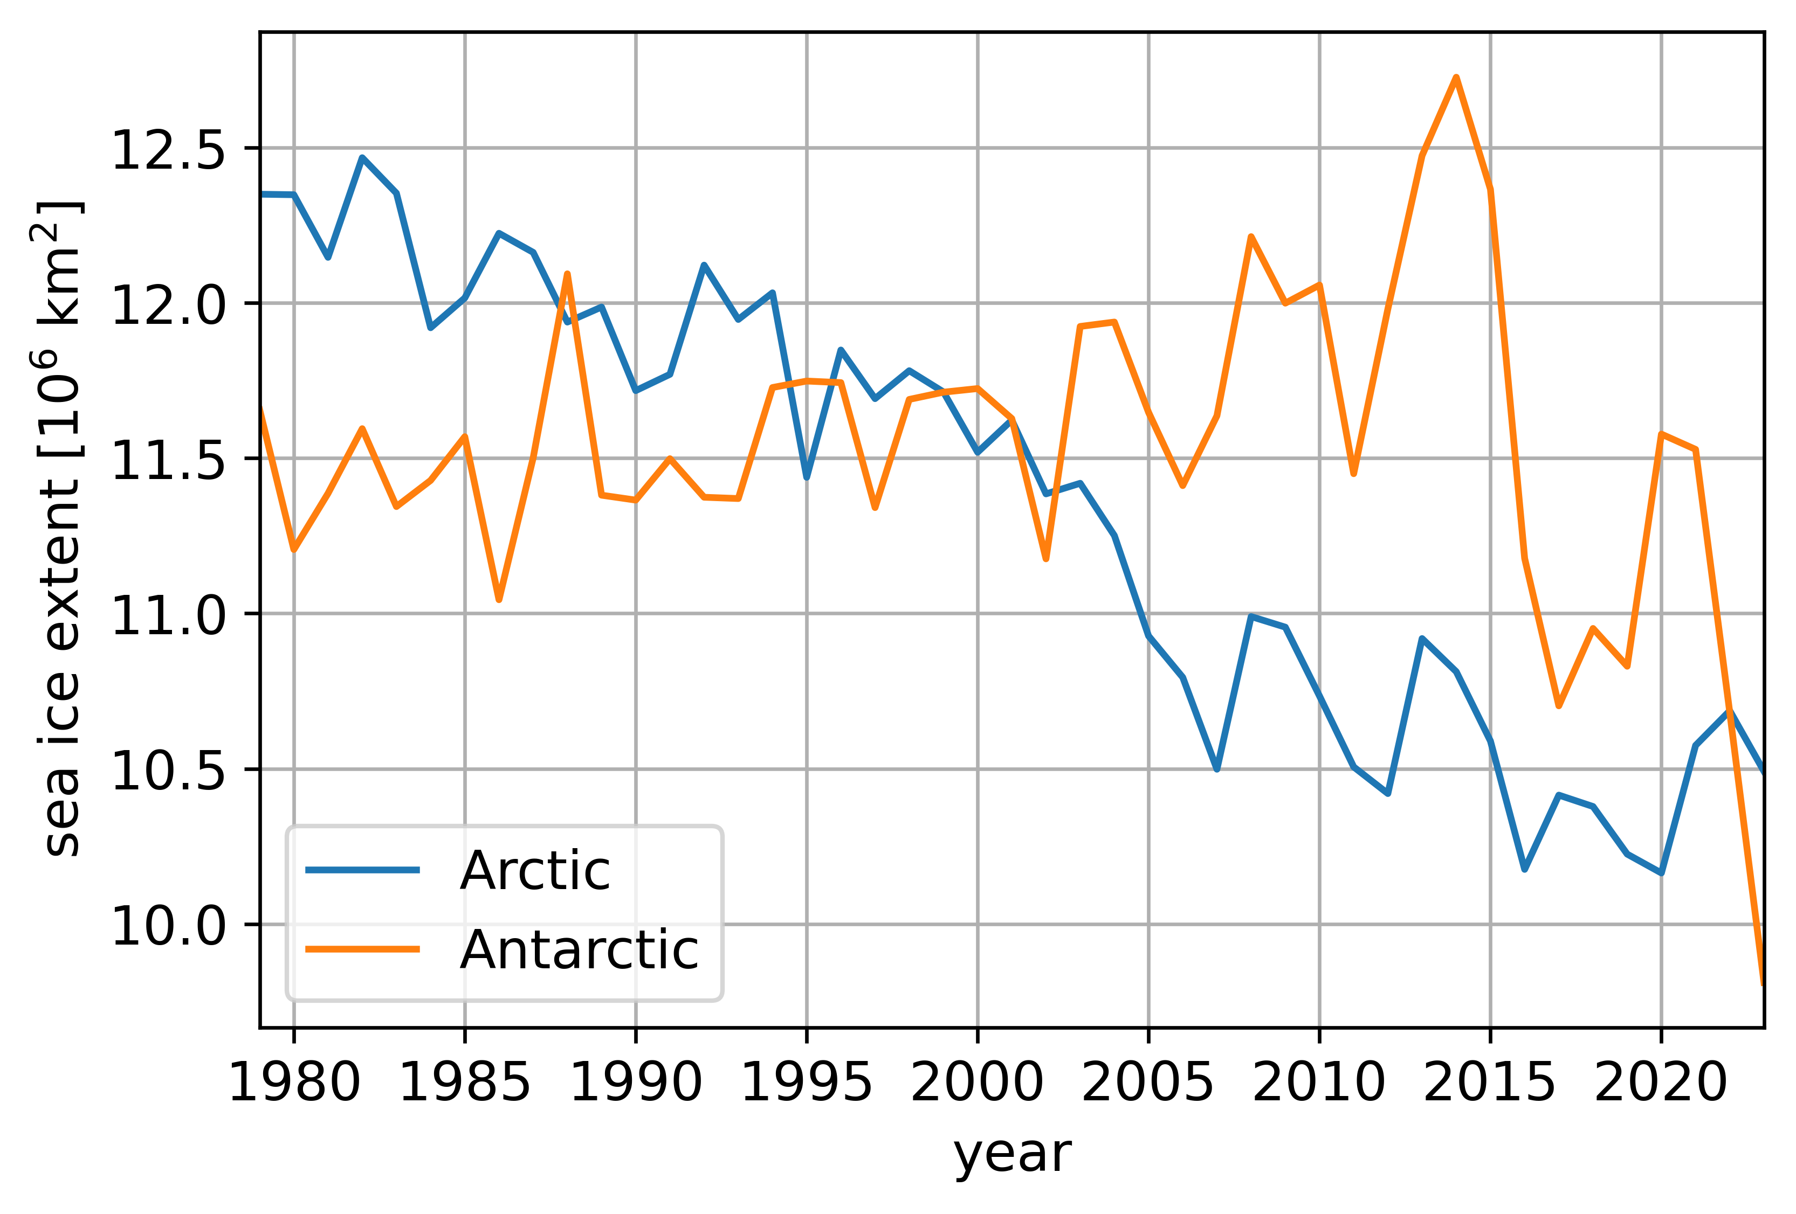
What is sea ice?
Arctic sea ice has declined steadily
Antarctic sea ice increased slightly from 1979-2015, and has declined sharply since
Models do not reproduce Antarctic sea ice well

Slide 5
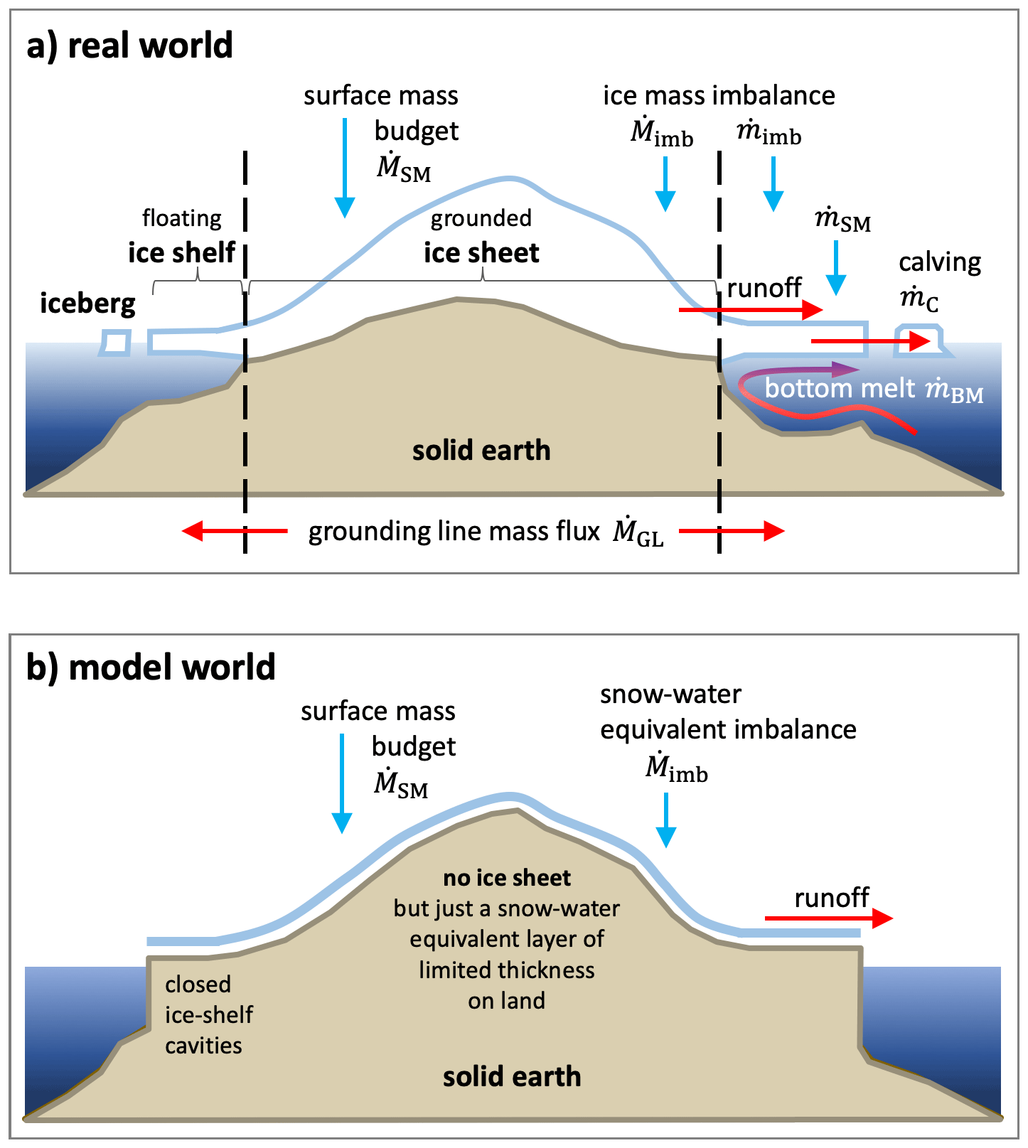
What is the Antarctic ice sheet?
Freshwater ice formed by compacting snow over hundreds of thousands of years
Several kilometres thick
Loses mass by calving icebergs and basal melting of ice shelves
Figure from Swart et al. (2023)

Slide 6
What is the problem?
Climate models do not have real ice sheets
Treat the ice sheet as land with snow on top
Antarctica cannot gain or lose mass
In reality, it’s losing mass
Missing source of freshwater to the Southern Ocean
Figure from Swart et al. (2023)

Slide 7
Why does it matter?
Adding fresh water cools the ocean surface
Results in more sea ice
Effect spreads far beyond Antarctica
Including it may result in less warming for NZ than current future projections
Figure from Dong et al. (2022)

Slide 8
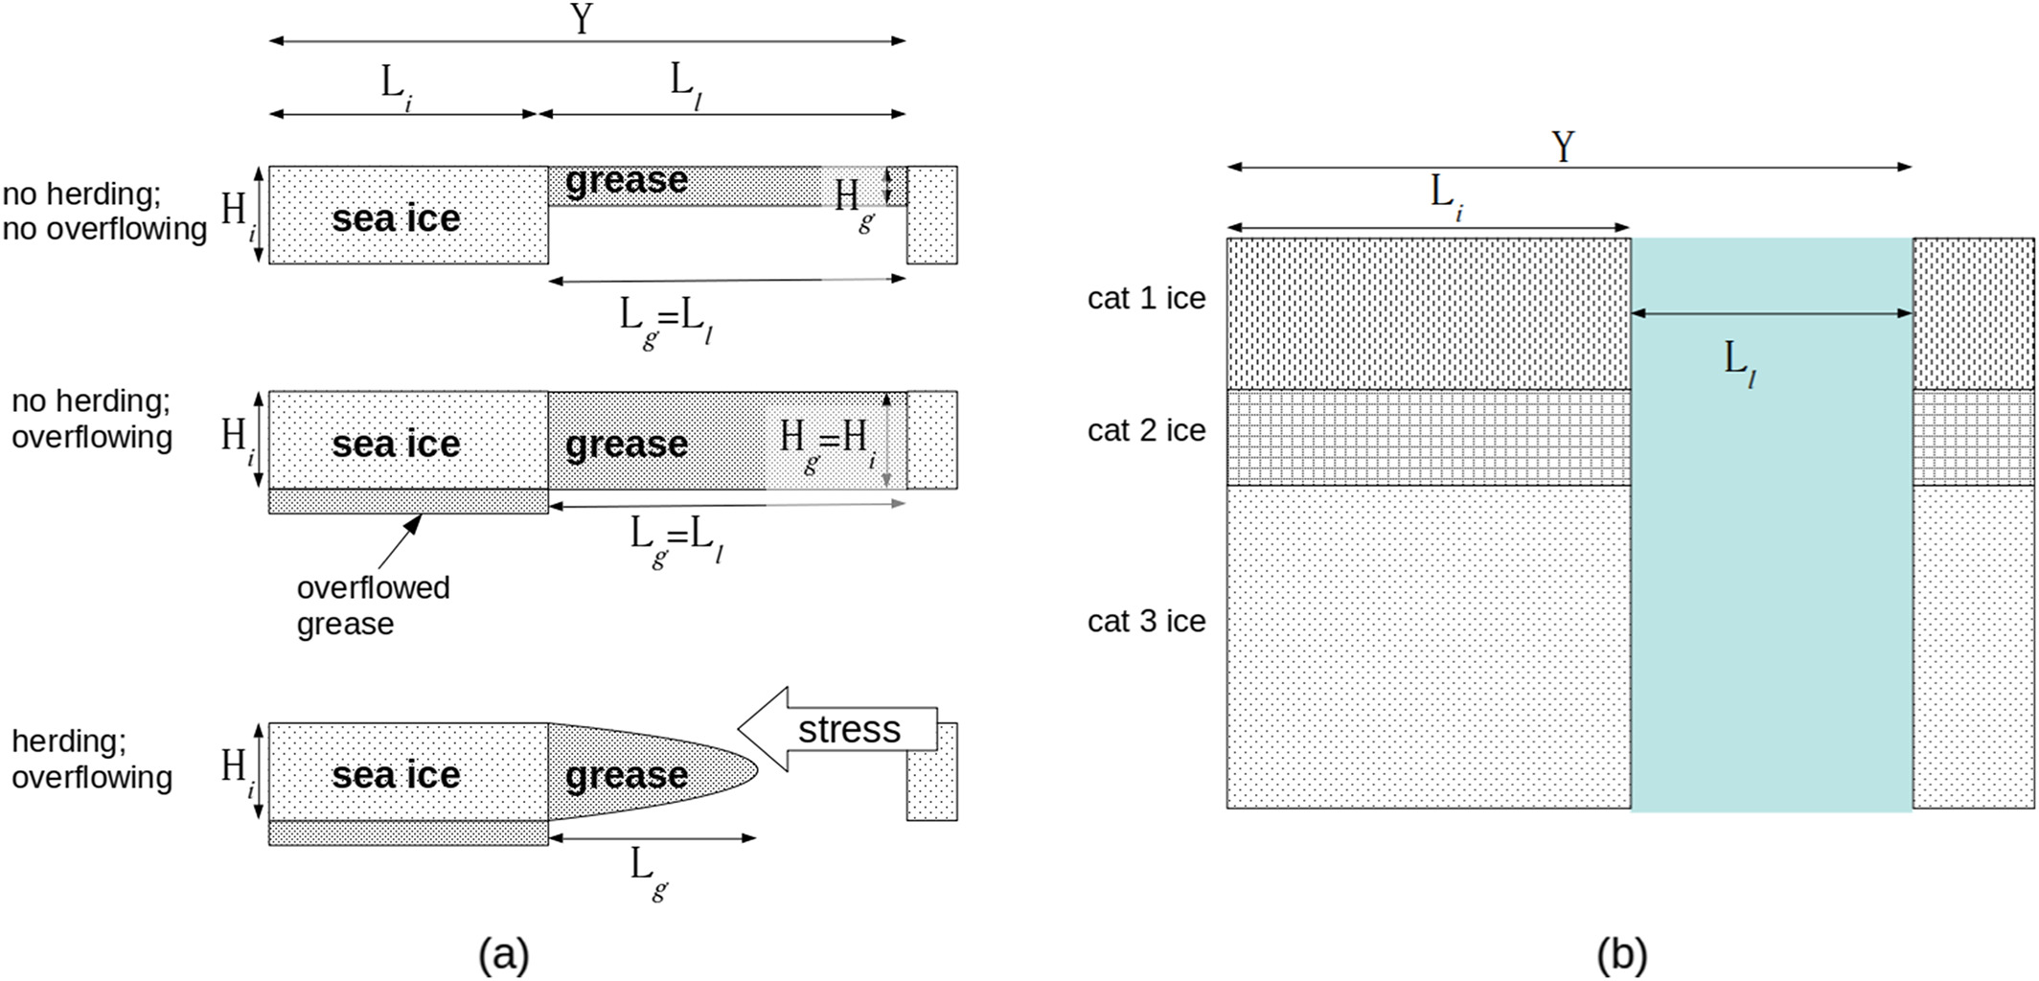
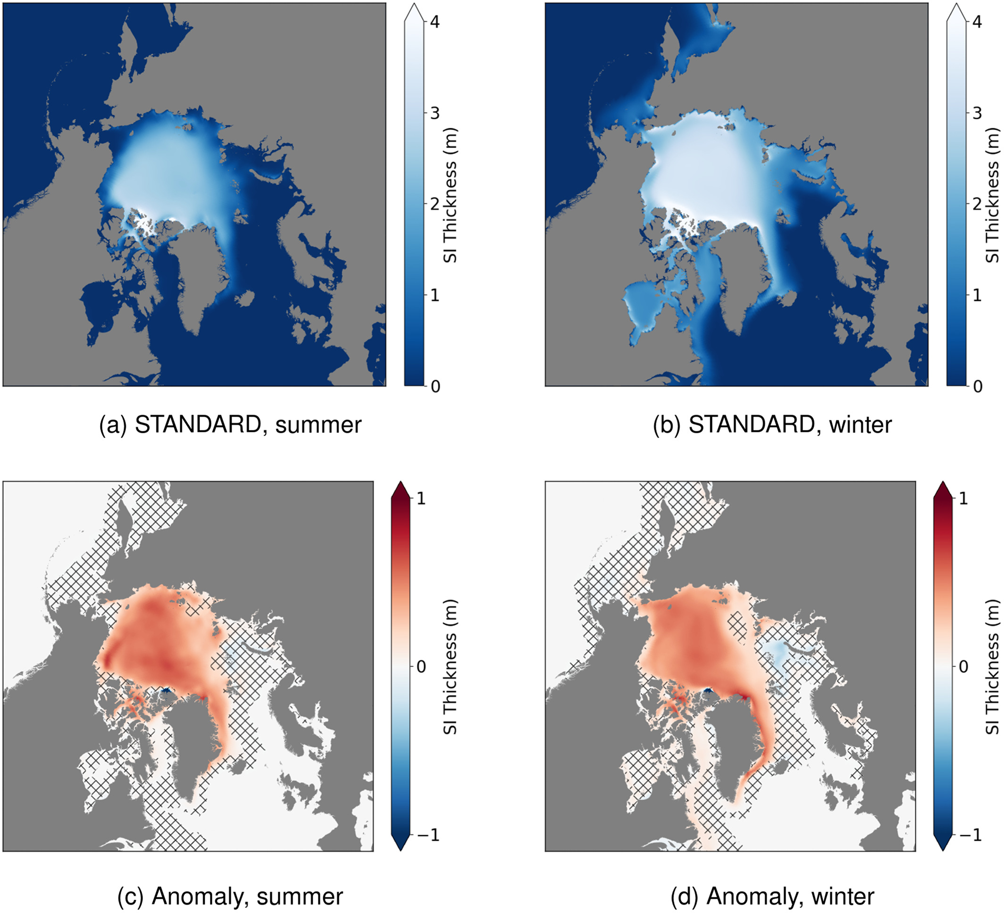
Grease ice parameterisation
Implemented a new parameterization for grease ice formation and herding in the Community Ice CodE (CICE) sea ice model
Tested the impact in the HadGEM3-GC3.1 climate model, the physical core of NZESM
Results in thicker sea ice in the Arctic.
Local effects in the Antarctic but little overall impact to total sea ice volume
Published in Mackie et al. (2020) JAMES

Slide 9
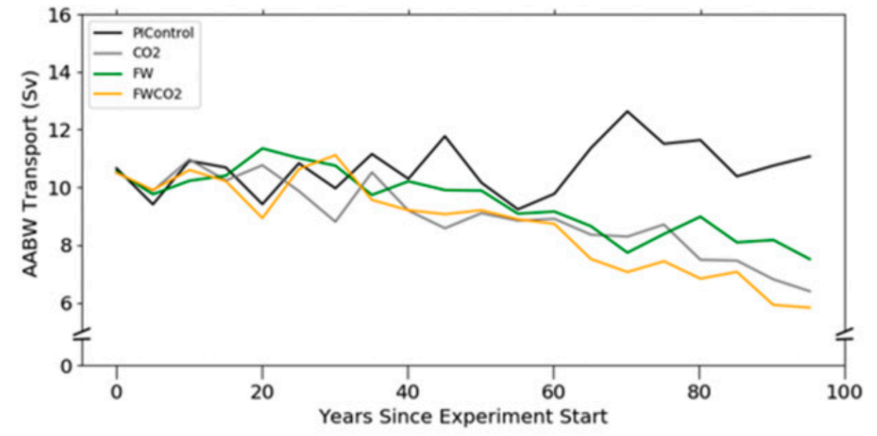
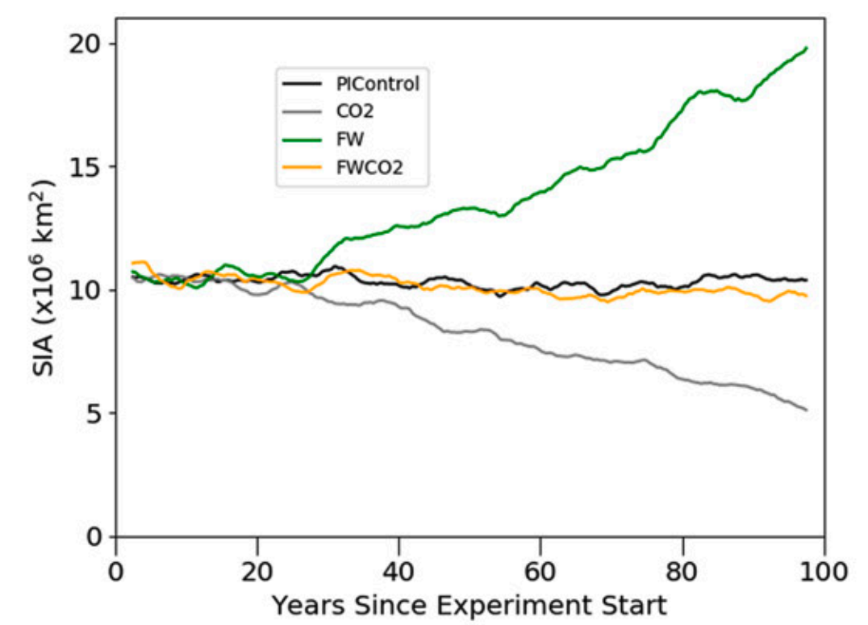
Impacts of Antarctic meltwater
Tested impact of ice shelf and iceberg melt under piControl and 1%CO₂ scenarios
Found differing effects of meltwater depending on whether it comes from ice shelf or iceberg melt
Increasing meltwater input is sufficient to offset the sea ice decline in 1%CO₂
Adding meltwater enhances projected decline in Antarctic Bottom Water formation
Published in Mackie et al. (2020a, 2020b) Journal of Climate

Slide 10
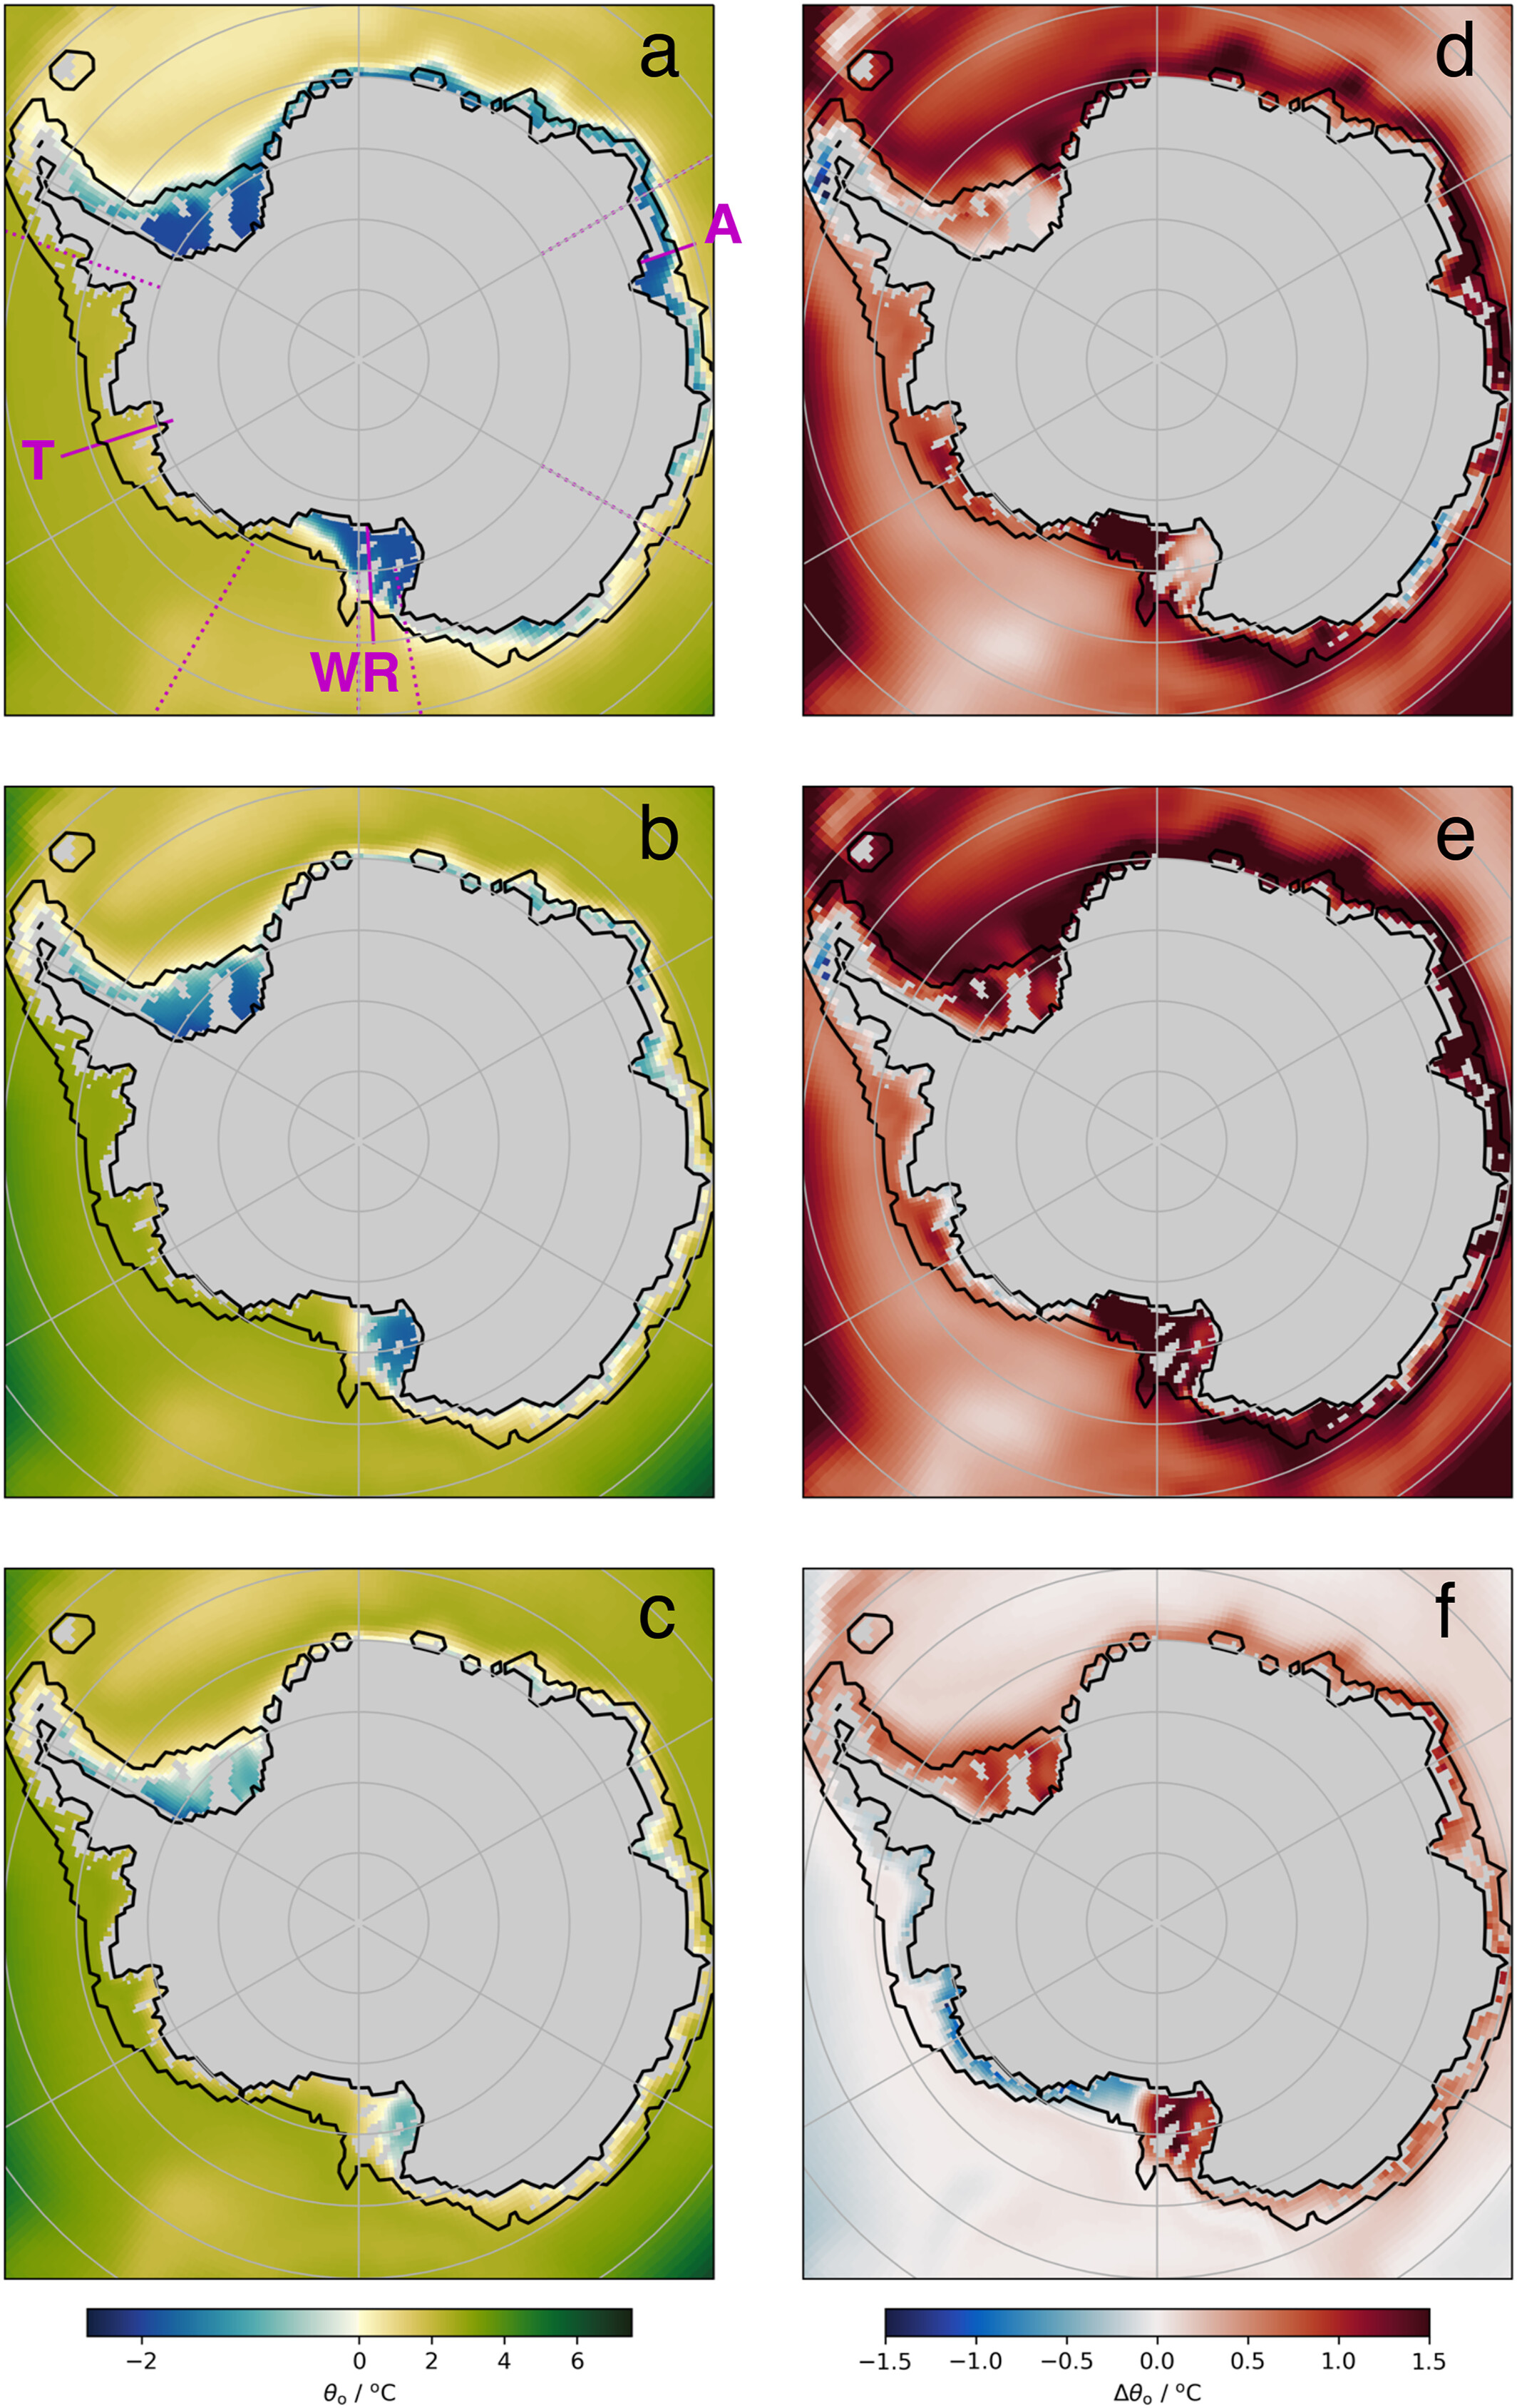
Impacts of Antarctic meltwater
Investigated the response of subsurface continental shelf waters to Antarctic meltwater in HadGEM3-GC3.1
Subsurface waters warm in response to fixed meltwater input under the SSP5-8.5 future warming scenario
Additional meltwater resulted in cooling in some regions, warming in others
Continental shelf waters response is dependent on continental shelf properties, climate, and the distribution of input.
Published in Thomas et al. (2023) Geophysical Research Letters

Slide 11
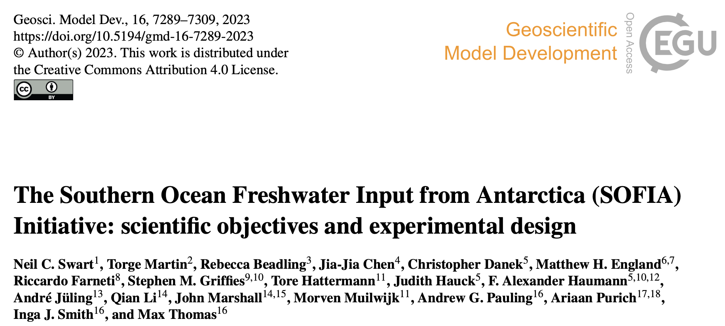
Impacts of Antarctic meltwater
Historically the impacts of Antarctic meltwater on Antarctic sea ice have varied widely depending on the model used
We are participating in a new international, multi-model intercomparison with standardized meltwater forcing: The Southern Ocean Freshwater Input from Antarctica (SOFIA) Initiative.

Slide 12
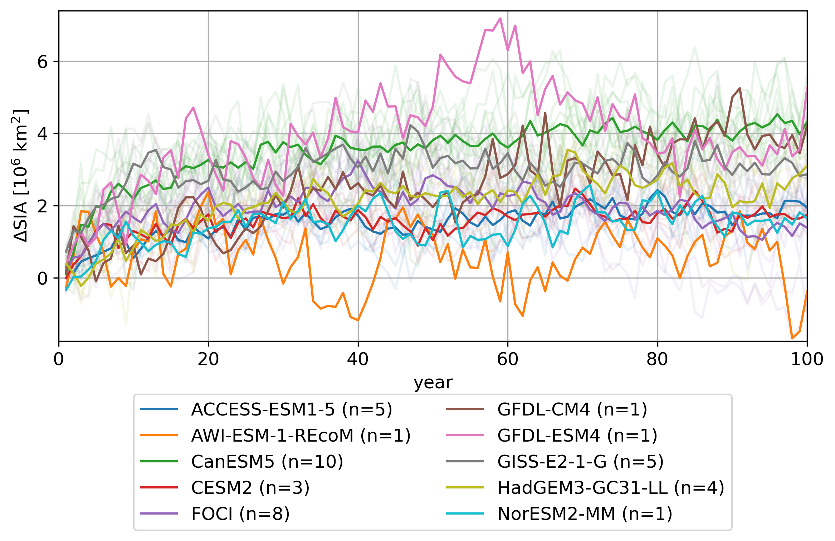
Impacts of Antarctic meltwater

Slide 13
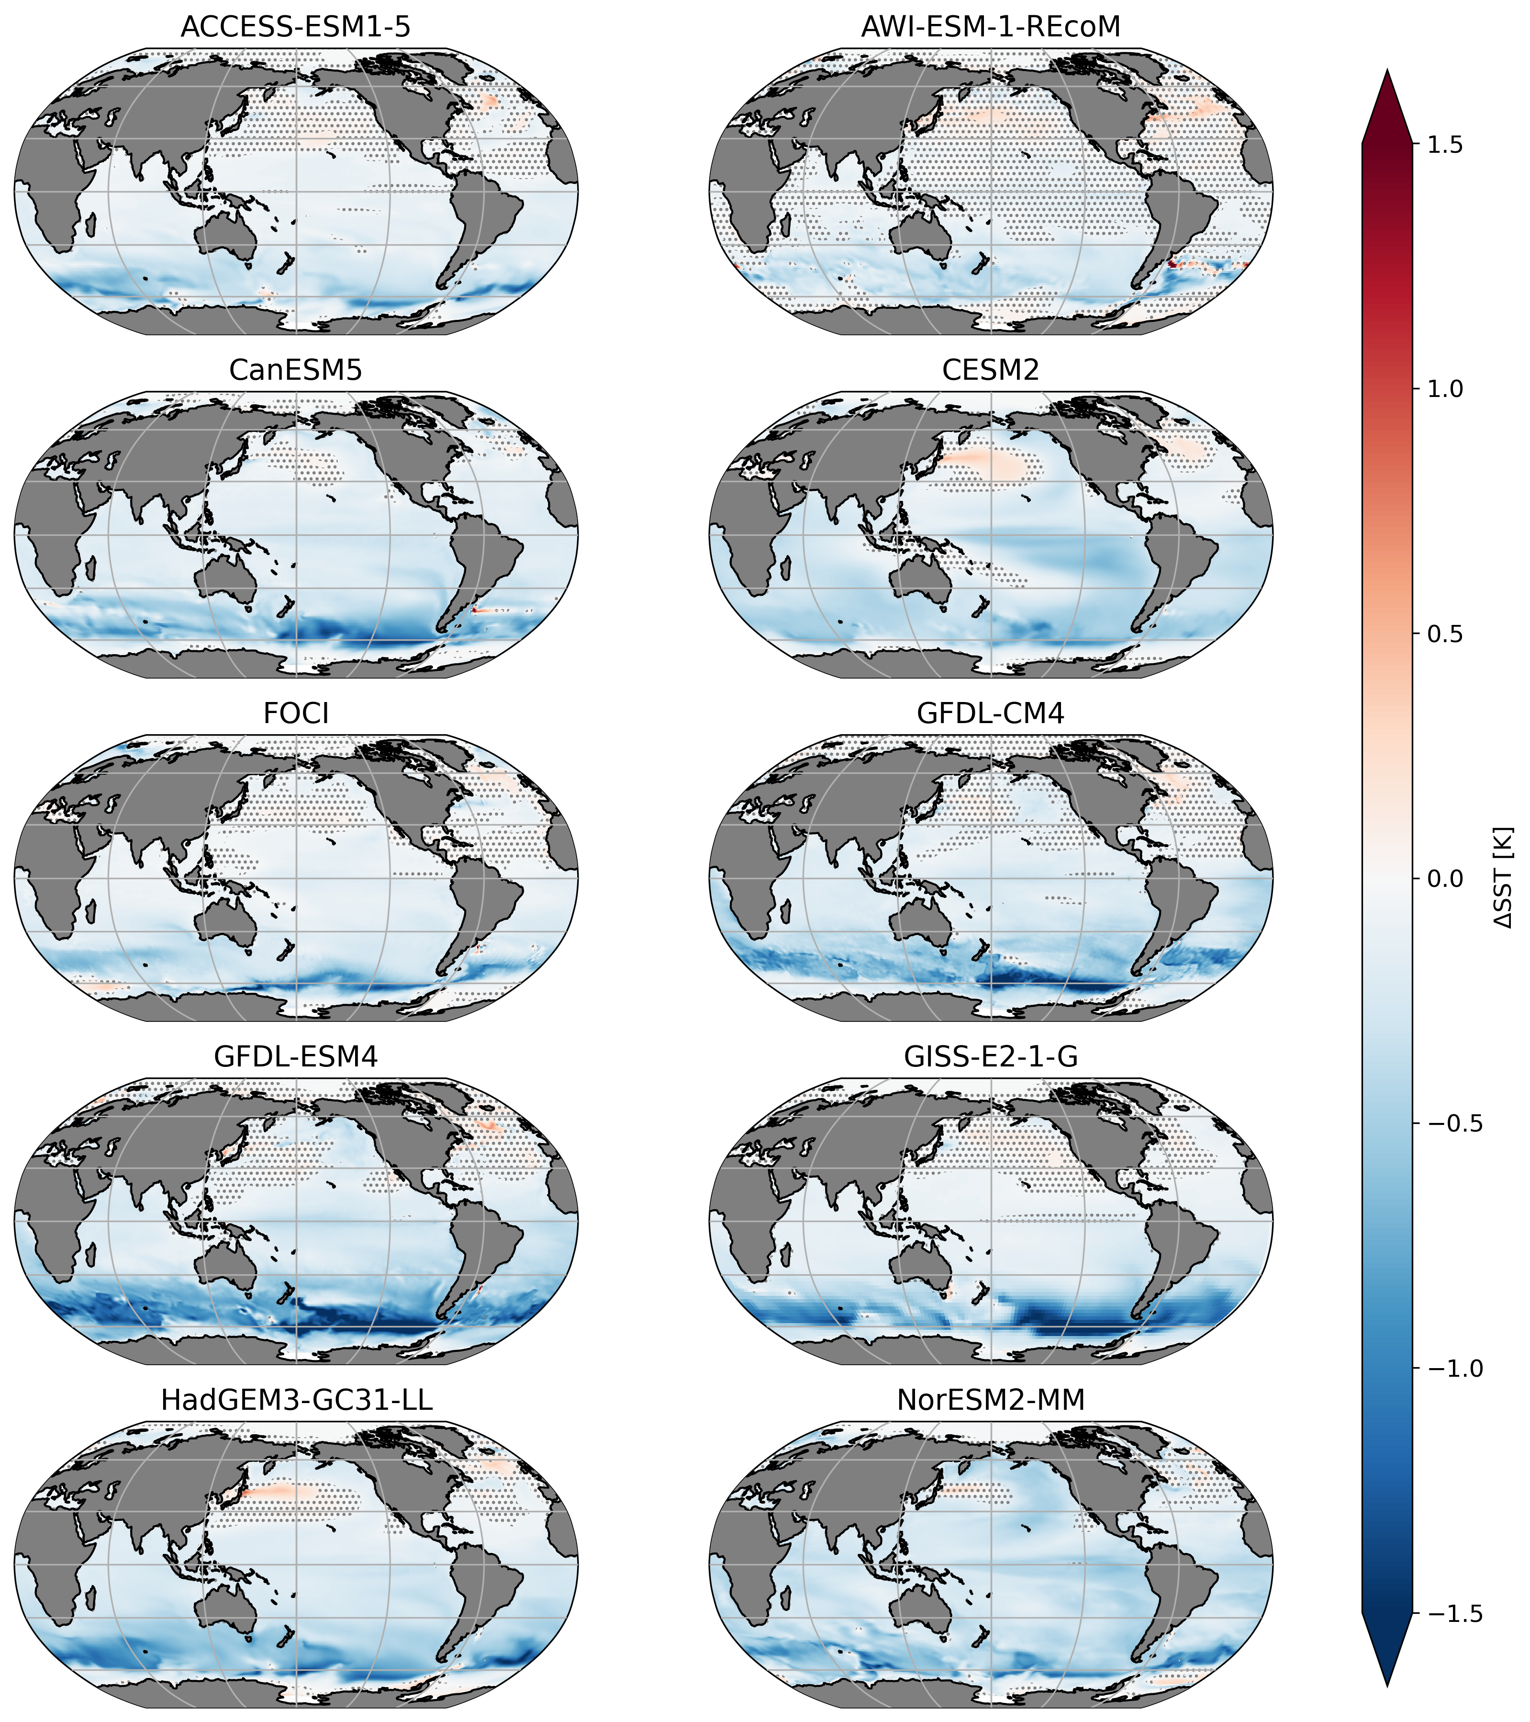
Impacts of Antarctic meltwater
Cooling across the Southern Ocean in all models
Extends up to New Zealand
Potential to reduce projections of warming when included in models

Slide 14
Impacts of Antarctic meltwater
Cooling of between 0.25 and 0.65ºC depending on the model
Highlights the importance of these model intercomparisons
NOTE: this is an idealised experiment and does not correspond to a future projection

Slide 15
Summary and Future Work
Meltwater from the Antarctic ice sheet is an important missing process in climate models
Has important implications for Antarctica and New Zealand
Model intercomparison project critical for quantifying uncertainty in model projections
Meltwater proposed to be included in CMIP7. We are involved.
Future scenarios including Antarctic meltwater being completed now. Results coming soon

